Slide 1

Inventory Management System
Prepared by:
Lana Abdulla & Adam Muhammed
Course Lecturer:
Ms. Yusra Mohammed & Ms. Bakhan
Date:
May 27, 2025

Slide 2

Introduction
Key Points:
Combines :OOP principles, MySQL database, and Java GUl for inventory management.
Supports two user roles: Admin(full access) and User(limited access).
Handles Accounting types (70, 71A, 71, 13, 16) for inventory tracking.
Uses prepared statements and secure database operations
2

Slide 3
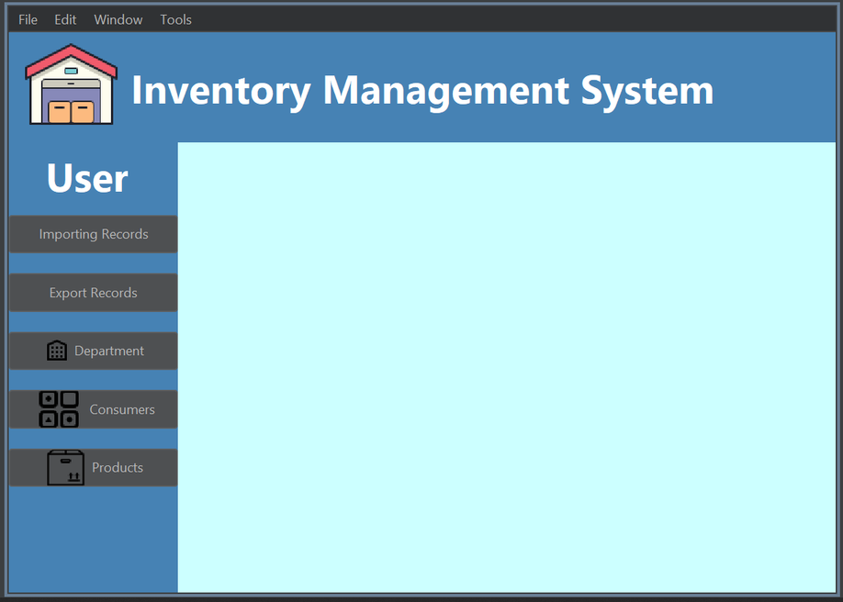
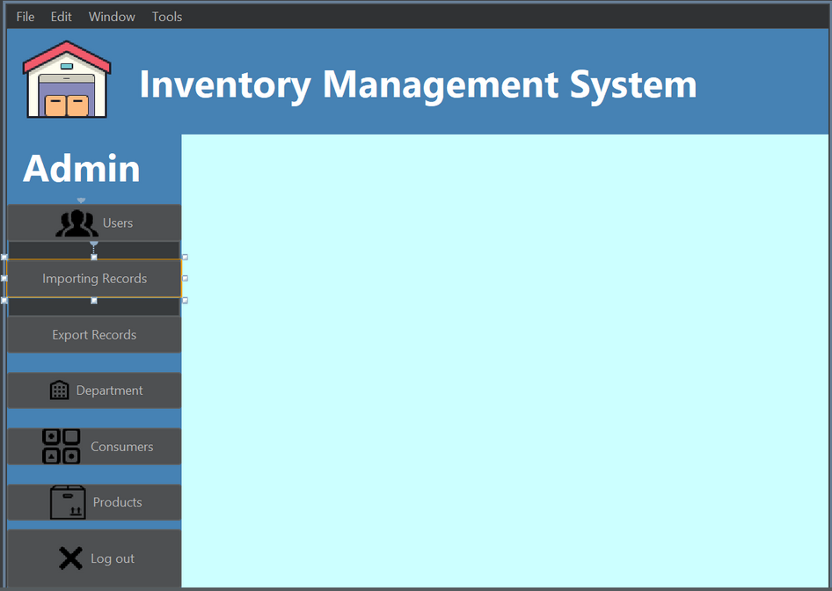
visual:
User Dashboard
Admin Dashboard

Slide 4
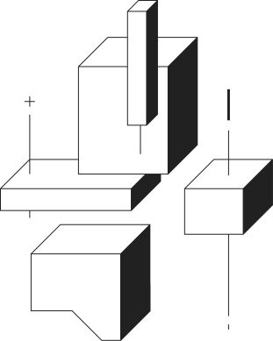
Problem Statement
Manual inventory tracking in government
warehouses leads to:
- Inefficiencies and errors.
- Lack of accountability.
- Need for a centralized system with:
- Role-based access control.
- Real-time data entry/reporting.
- Secure database integration.
4

Slide 5
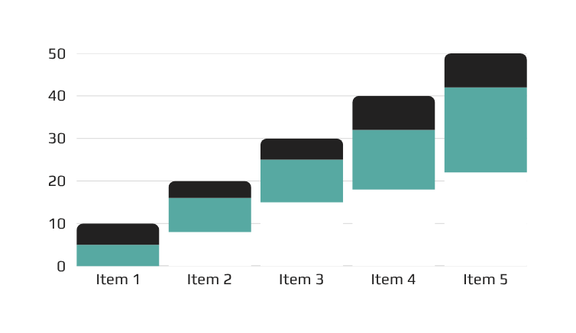
Proposed Solution
Java desktop application with MySQL backend.
Features:
- Secure login (Admin/User roles).
- Multiple accounting types (70, 71A, etc.).
- User management (Add/Delete/Update).
Design principles:
- Encapsulation (private variables in `Import.java`, `Users.java`).
- Inheritance (`Admin_Dashboard` extends `JFrame`).
- Polymorphism (overriding `actionPerformed()` for buttons).

Slide 6
Implementation
Workflow Diagram
SQL Commands
- Example:
Adding an Import Record
```plaintext
Start → Open Import Form → Enter Data → Validate Input → [No] → Show Error
↓
[Yes] → Save to Database → Show Success → Clear Form → End
`sql
-- Create Users Table
CREATE TABLE `users` (
`ID` int NOT NULL AUTO_INCREMENT,
`username` varchar(45) NOT NULL,
`password` varchar(45) NOT NULL,
`role` varchar(45) NOT NULL,
`birthdate` date NOT NULL,
PRIMARY KEY (`ID`)
);

Slide 7

Implementation
Java Classes
- Example from `Import.java`:
```java
public void addImport() {
String sql = "INSERT INTO `accounting 71 a` (...) VALUES (?,?,...)";
PreparedStatement pst = con.prepareStatement(sql);
// Set parameters...
}

Slide 8
Conclusion & Future Work
Conclusion:
- Successfully integrated OOP, database design, and GUI programming.
- Supports secure login, role-based access, and real-time reporting.
Future Work:
- Export reports to Excel/PDF.
- Mobile compatibility.
- Advanced reporting (e.g., top 5 expensive products).

Slide 9
References
· Barewbarayate benasazi slimanyi
·Al-khalifa, K. N., & Aspinwall, E. M. (2000). TQM age versus quality: An empirical investigation . Production & Inventory Management Journal, 1, 18–23.
·Baral, P., Larsen, M., & Archer, M. (2019). Does money grow on trees? (Report No. 12345). Washington, DC: World Bank Publications.
·Emerald Insight. (n.d.). REFERENCES: Inventory Management Models: A Tutorial . Name of Workshop Facilitator

